Slide 1
Cloud Computing
SEWP ZG527

Slide 2
SaaS – Agenda
What is SaaS?
Traditional Model
How is it delivered?
SaaS Architecture
SaaS Models
Advantages of SaaS
User and Vendor benefits of SaaS
2

Slide 3
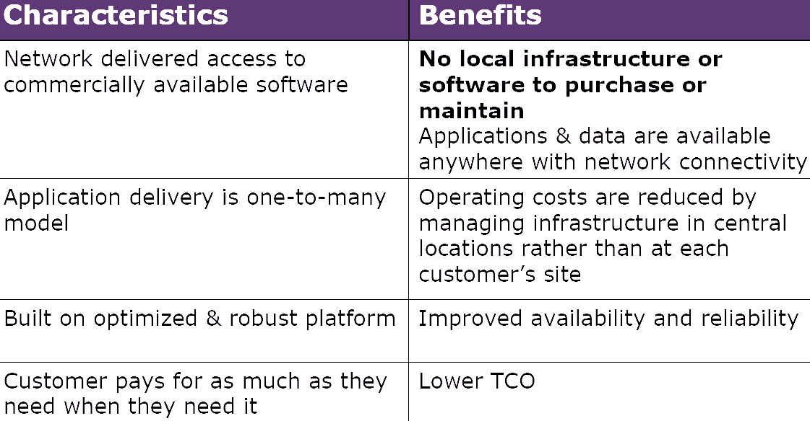
SaaS Advantages
Notes:
RL 5.3

Slide 4
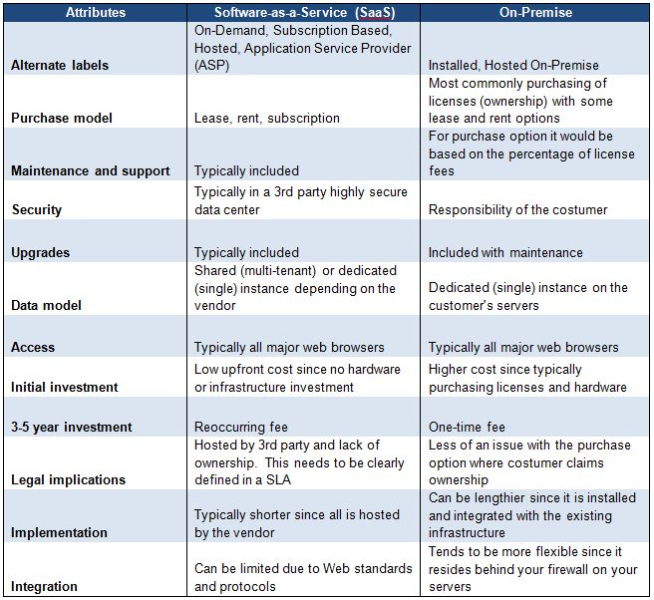

Slide 5
SaaS User Benefits
Lower Cost of Ownership
The software is paid when it is consumed, no large upfront cost for a software license Salesforce.com has a best-of-breed CRM system for $59.00 per user per month, with no upfront
Since no hardware infrastructure, installation, maintenance, and administration, budgeting is easy
The software is available immediately upon purchasing
Focus on Core Competency
The IT saving on capital and effort allows the customer to remain focused on their core competency and utilize resources in more strategic areas.

Slide 6
SaaS User Benefits
Access Anywhere
Users can use their applications and access their data anywhere they have an Internet connection and a computing device
This enhances the customer experience of the software and makes it easier for users to get work done fast
Freedom to Choose (or Better Software)
The pay-as-you-go (PAYG) nature of SaaS enables users to select applications they wish to use and to stop using those that no longer meet their needs. Ultimately, this freedom leads to better software applications because vendors must be receptive to customer needs and wants.

Slide 7
SaaS User Benefits
New Application Types
Since the barrier to use the software for the first time is low, it is now feasible to develop applications that may have an occasional use model. This would be impossible in the perpetual license model. If a high upfront cost were required the number of participants would be much smaller.
Faster Product Cycles
Product releases are much more frequent, but contain fewer new features than the typical releases in the perpetual license model because the developer know the environment the software needs to run
This new process gets bug fixes out faster and allows users to digest new features in smaller bites, which ultimately makes the users more productive than they were under the previous model.

Slide 8
SaaS Vendor Benefits
Increased Total Available Market
Lower upfront costs and reduced infrastructure capital translate into a much larger available market for the software vendor, because users that previously could not afford the software license or lacked the skill to support the necessary infrastructure are potential customers.
A related benefit is that the decision maker for the purchase of a SaaS application will be at a department level rather than the enterprise level that is typical for the perpetual license model. This results in shorter sales cycles.

Slide 9
SaaS Vendor Benefits
Enhanced Competitive Differentiation
The ability to deliver applications via the SaaS model enhances a software company’s competitive differentiation. It also creates opportunities for new companies to compete effectively with larger vendors.
On the other hand, software companies will face ever-increasing pressure from their competitors to move to the SaaS model.
Those who lag behind will find it difficult to catch up as the software industry continues to rapidly evolve.

Slide 10
SaaS Vendor Benefits
Lower Development Costs & Quicker Time-to-Market
The main saving is at testing (35%).
Small and frequent releases – less to test
Application is developed to be deployed on a specific hardware infrastructure, far less number of possible environment – less to test.
This, in turn, provides the software developer with overall lower development costs and quicker time-to-market.
Effective Low Cost Marketing
Between 1995 and today, buyers’ habits shifted from an outbound world driven by field sales and print advertising to an inbound world driven by Internet search.

Slide 11
SaaS Vendor Benefits
Predictable MRR Revenue
Traditionally, software companies rely on one major release every 12-18 months to fuel a revenue stream from the sale of upgrades (long tail theory).
In the SaaS model the revenue is typically in the form of Monthly Recurring Revenue (MRR)
Improved Customer Relationships
SaaS contributes to improved relationships between vendors and customers.
Protecting of IP
Difficult to obtain illegal copies
Price is low, making getting an illegal copies totally unnecessary

Slide 12
Applicability – Scenario 1
Single-User software application
Organize personal information
Run on users’ own local computer
Serve only one user at a time
Inapplicable to Saas model
Data security issue
Network performance issue
Example: Microsoft office suite

Slide 13
Applicability – Scenario 2
Infrastructure software
Serve as the foundation for most other enterprise software application
Inapplicable to Saas model
Installation locally is required
Form the basis to run other application
Example: Window XP, Oracle database

Slide 14
Applicability – Scenario 3
Embedded Software
Software component for embedded system
Support the functionality of the hardware device
Inapplicable to Saas model
Embedded software and hardware is combined together and is inseparable
Example: software embedded in ATM machines, cell phones, routers, medical equipment, etc

Slide 15
Applicability – Scenario 4
Enterprise Software Application
Perform business functions
Organize internal and external information
Share data among internal and external users
The most standard type of software applicable to Saas model
Example: Saleforce.com CRM application, Siebel On-demand application

Slide 16
Thanks!!!
Queries?

